Slide 1
Six Guys Hackathon
By 6 Guys
22/08/2024

Slide 2
Task 1-Directory reconstruction

Slide 3
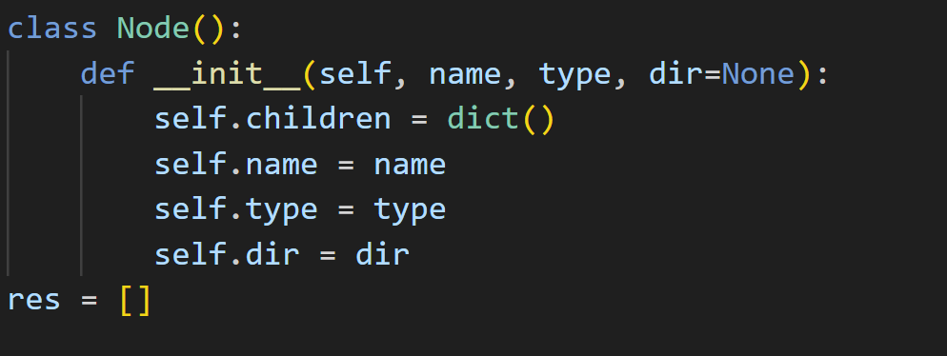
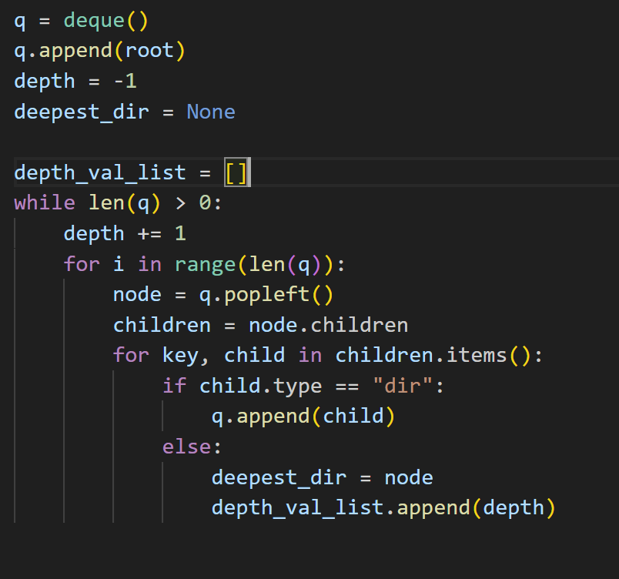
First Version
Graph based approach
Used a depth first search to find depth

Slide 4
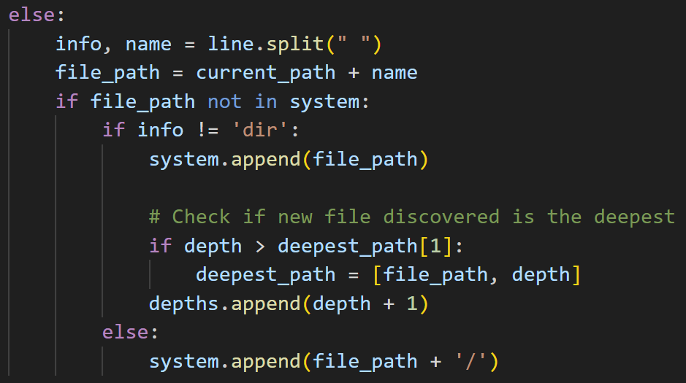
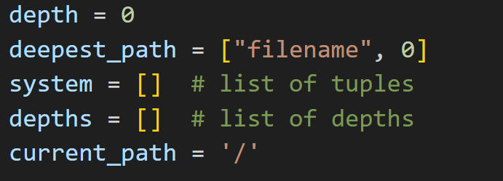
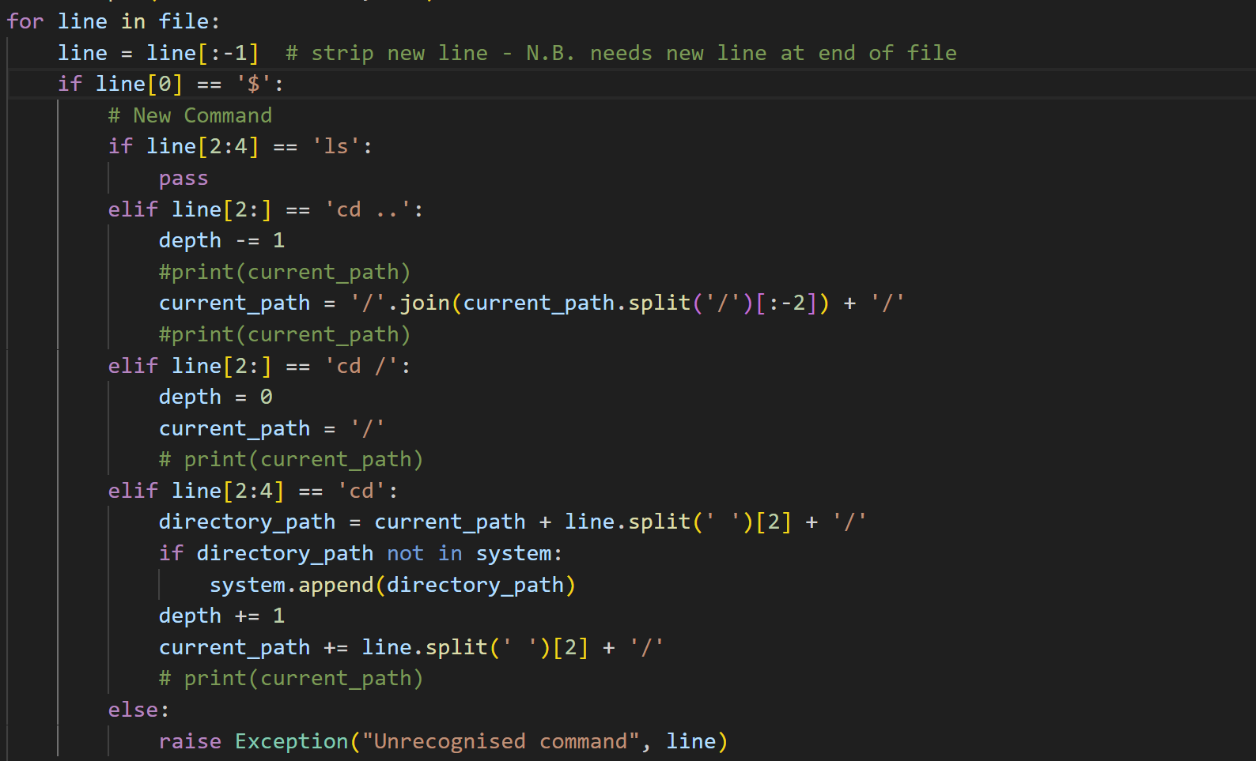
Final version
“store as we go”

Slide 5
Task 2

Slide 6
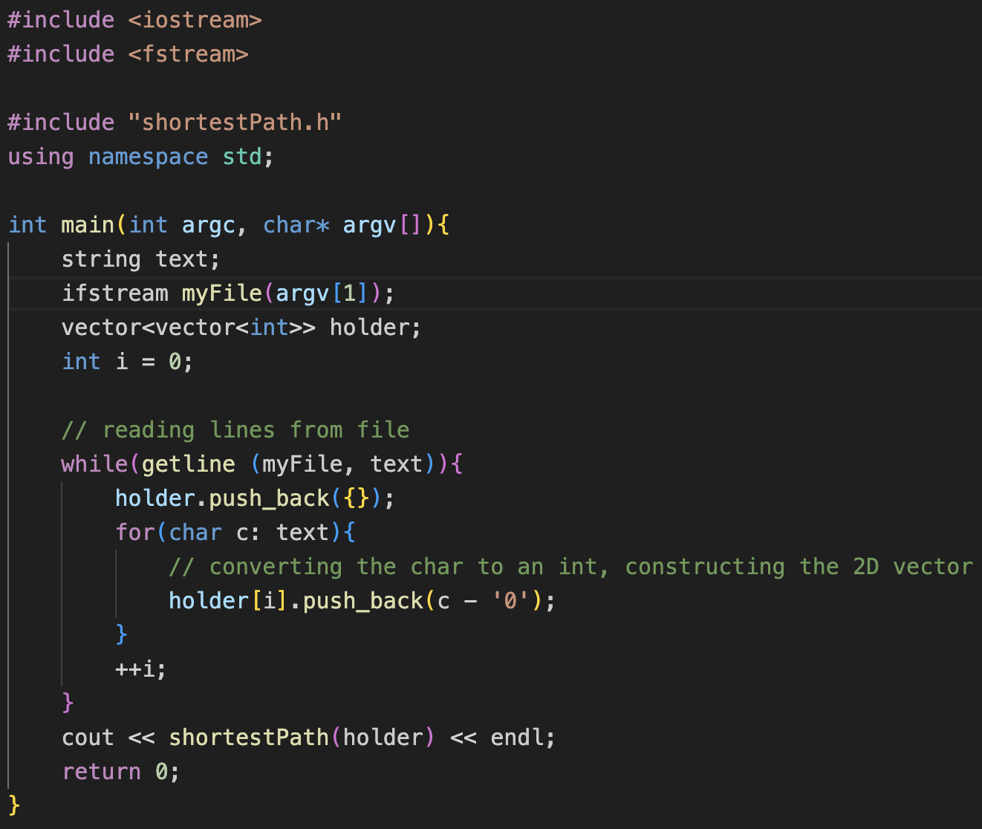
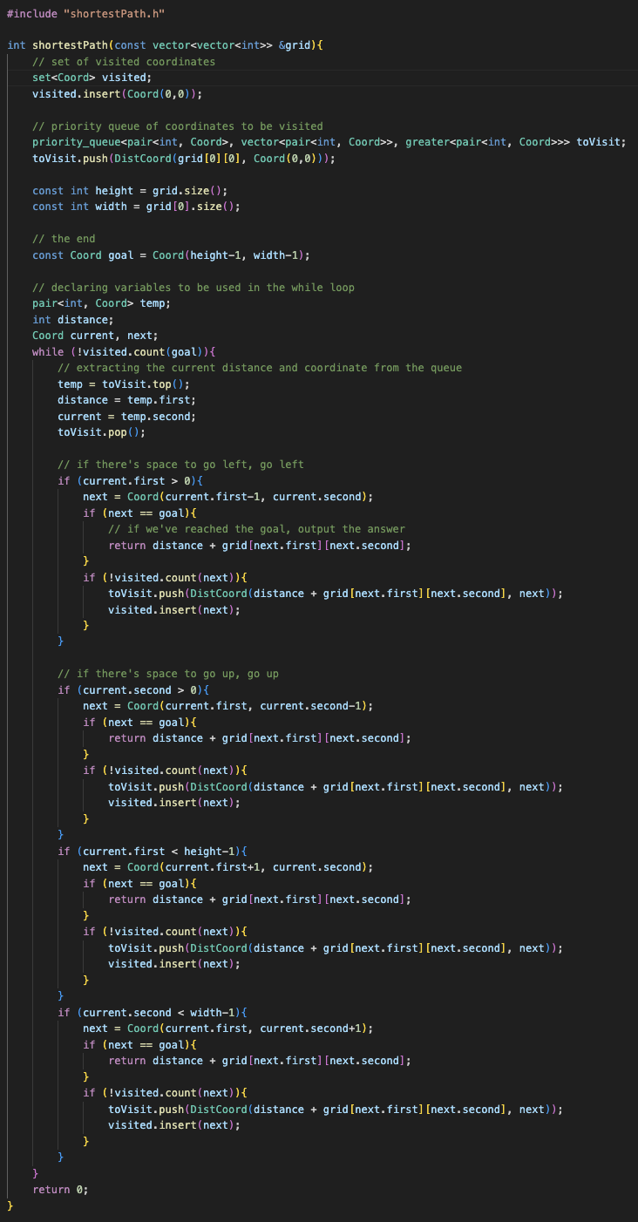
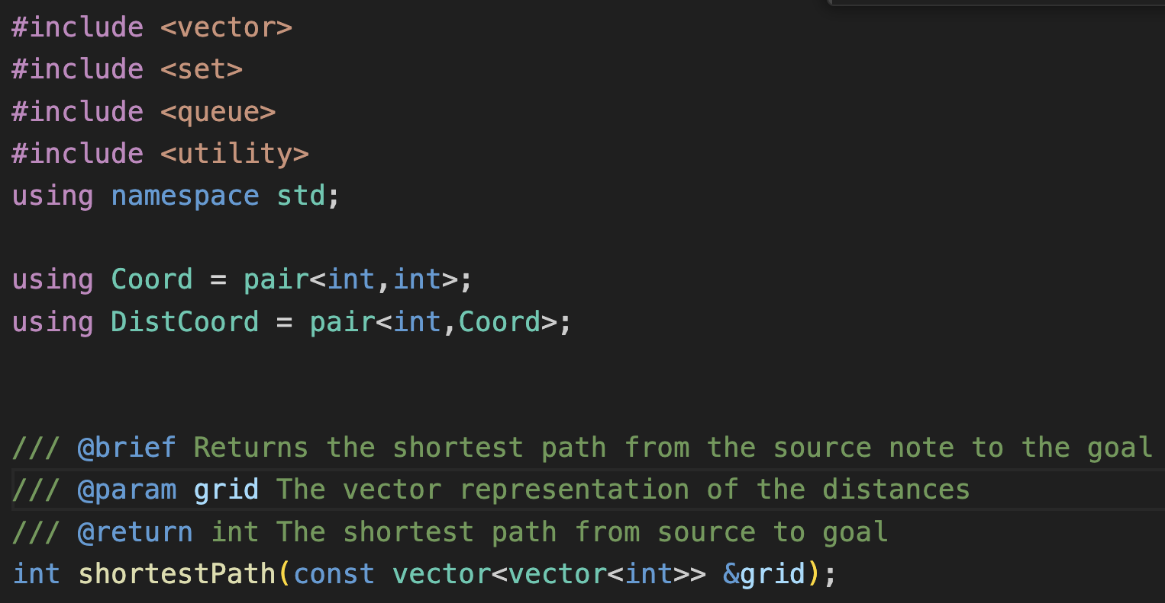
Task 2

Slide 7
Benchmarking

Slide 8
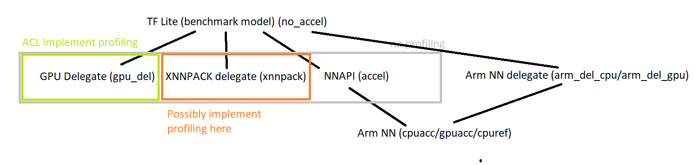
Benchmark ML SW – TF Lite backends
Higher
Same numbers used for flow identification
1
2
4
8

Slide 9
Benchmarking via CI system (Jenkins)

Slide 10
Benchmark ML SW – 4 & 5
NN API + Arm NN (AndroidNN)
Find an available device : https://engsys1.ml.arm.com/lockable-resources/
oneplus8-pro-remote-88718767
Running in Jenkins:
cd benchmark-ck
vscode .
Modify ck-ivg-bench/script/workload-scripts/core/standalone/JenkinsRun
jbp.slack_targets = ['@stuart.taylor']
job = 'TFLite'
jbp.workload_scripts = ['tensorflow.lite.WorkloadsNightly']
jbp.build_job_name = '/armnn/devenv/builds/armnn.devenv.NightlyBuild'
jbp.android_devices = ['oneplus8-pro-remote-88718767']
jbp.extra_cmd_args = '--tf_versions v2.2.0 --tf_programs label --compute cpuacc -c2 3xG585_max -n tflitemodel-efficientnet_b0-int8-armzoo -p int8'
python3 -m core.standalone.JenkinsRun
5
For profiling add: --profiling
cpuacc: AnrdoiNN + ArmNN cpu
gpuacc: AnrdoiNN + ArmNN gpu

Slide 11
Task 3- StockIt

Slide 12
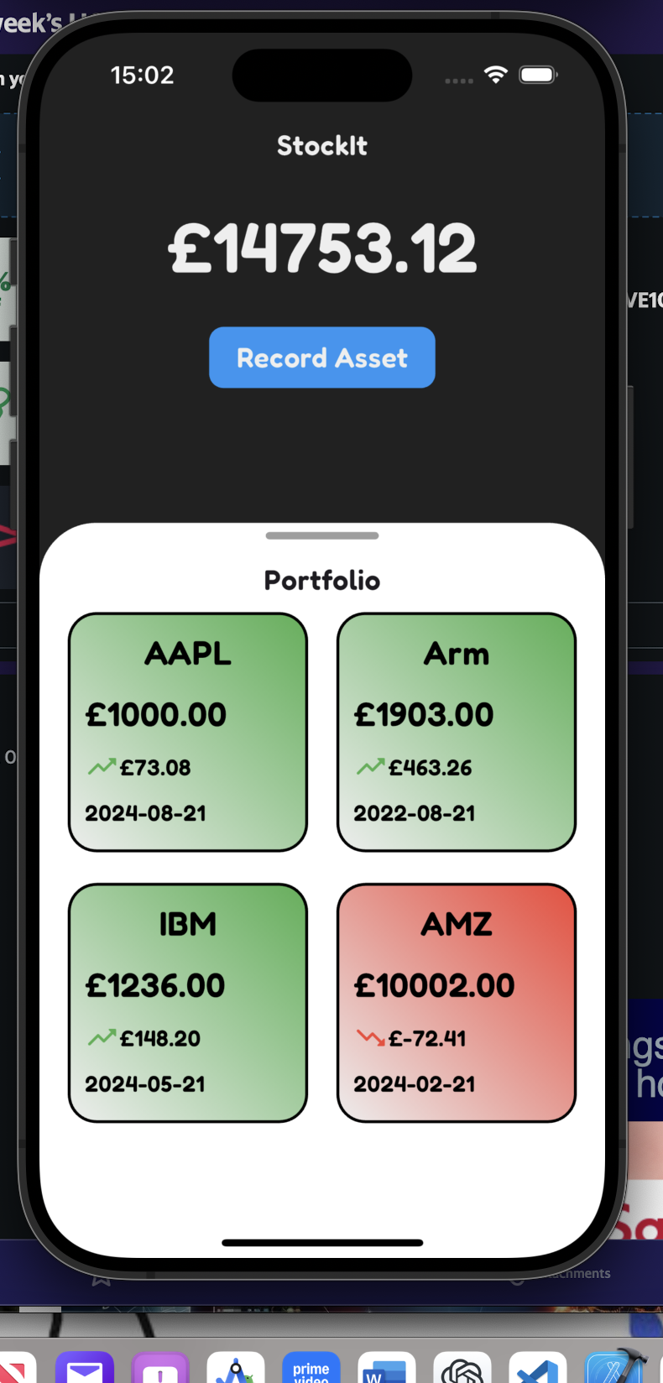
StockIt App
Made with Flutter
Calculations:
Number of Shares = Money Invested/Old Share Price
New Value = New Share Price * Number of Shares
P/L = New Value - Money Invested

